Slide 1
Unit III: Design Methods and Models (08 Hrs)
The Design Process, Concepts of design, Design Quality, Design Principles,
Object-Oriented Design Concepts, Design Classes, The Design Model and elements;
Software Architecture, Importance, Architectural Styles, Architectural
Design, Assessing Alternative Architectural Designs using Architectural Styles in
Designs;
Component Design, Class-Based Components, Conducting Component Level Design, Component Level Design for WebApps;
User Interface Design, The Golden Rules , User Interface Analysis and Design, Interface Analysis, Interface Design Steps, WebApp Interface Design, Design Evaluation;
Design Document, Modifiability: SAAM Method, ATAM Method, The HASARD Method.
Software Engineering

Slide 2
Part I. Design Process
.
Software Engineering

Slide 3

Design Process
Analysis Model -> Design Model
Software Engineering

Slide 4
Fundamental Concepts
abstraction—data, procedure, control
architecture—the overall structure of the software
patterns—”conveys the essence” of a proven design solution
modularity—compartmentalization of data and function
hiding—controlled interfaces
Functional independence—single-minded function and low coupling
refinement—elaboration of detail for all abstractions
Refactoring—a reorganization technique that simplifies the design
Software Engineering

Slide 5
Data Abstraction
door
manufacturer
model number
type
swing direction
inserts
lights
type
number
weight
opening mechanism
implemented as a data structure
Software Engineering

Slide 6
Procedural Abstraction
open
details of enter
algorithm
implemented with a "knowledge" of the
object that is associated with enter
Software Engineering

Slide 7
Architecture
“The overall structure of the software and the ways in which that structure provides conceptual integrity for a system.”
Structural properties. This aspect of the architectural design representation defines the components of a system (e.g., modules, objects, filters) and the manner in which those components are packaged and interact with one another. For example, objects are packaged to encapsulate both data and the processing that manipulates the data and interact via the invocation of methods
Extra-functional properties. The architectural design description should address how the design architecture achieves requirements for performance, capacity, reliability, security, adaptability, and other system characteristics.
Families of related systems. The architectural design should draw upon repeatable patterns that are commonly encountered in the design of families of similar systems. In essence, the design should have the ability to reuse architectural building blocks.
Software Engineering

Slide 8
Patterns
Design Pattern Template
Pattern name—describes the essence of the pattern in a short but expressive name
Intent—describes the pattern and what it does
Also-known-as—lists any synonyms for the pattern
Motivation—provides an example of the problem
Applicability—notes specific design situations in which the pattern is applicable
Structure—describes the classes that are required to implement the pattern
Participants—describes the responsibilities of the classes that are required to implement the pattern
Collaborations—describes how the participants collaborate to carry out their responsibilities
Consequences—describes the “design forces” that affect the pattern and the potential trade-offs that must be considered when the pattern is implemented
Related patterns—cross-references related design patterns
Software Engineering

Slide 9
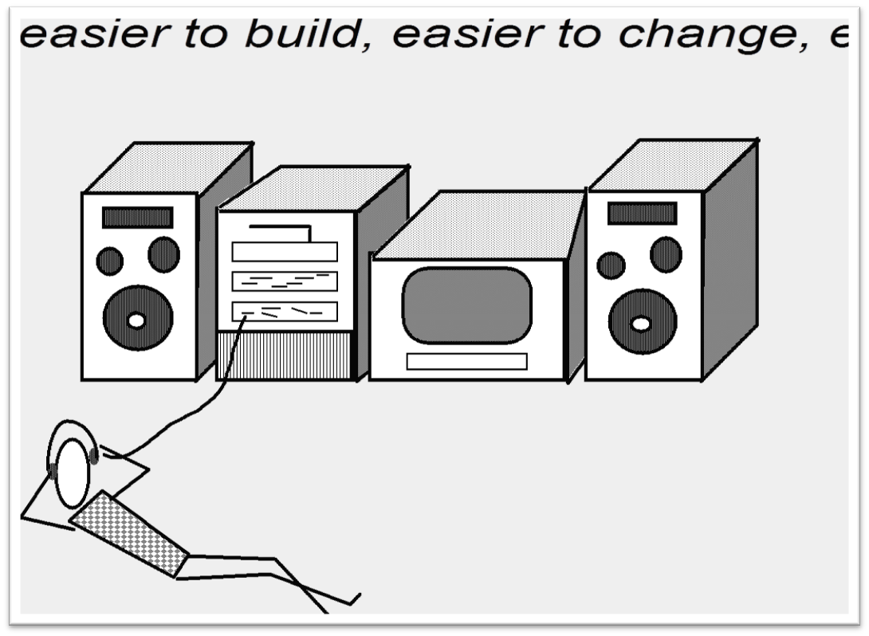
Modular Design
Software Engineering

Slide 10
Modularity: Trade-offs
What is the "right" number of modules
for a specific software design?
module development cost
cost of
software
module
integration
cost
optimal number
number of modules
of modules
Software Engineering

Slide 11
Information Hiding
module
• algorithm
controlled
interface
• data structure
• details of external interface
• resource allocation policy
clients
"secret"
a specific design decision
Software Engineering

Slide 12
Why Information Hiding?
reduces the likelihood of “side effects”
limits the global impact of local design decisions
emphasizes communication through controlled interfaces
discourages the use of global data
leads to encapsulation—an attribute of high quality design
results in higher quality software
Software Engineering

Slide 13
Stepwise Refinement
open
walk to door;
reach for knob;
open door;
repeat until door opens
turn knob clockwise;
walk through;
if knob doesn't turn, then
close door.
take key out;
find correct key;
insert in lock;
endif
pull/push door
move out of way;
end repeat
Software Engineering

Slide 14
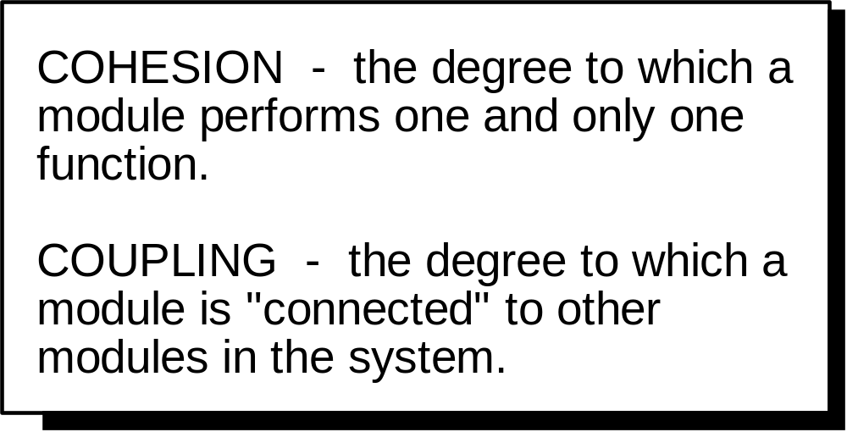
Functional Independence
Software Engineering

Slide 15

Sizing Modules: Two Views
Software Engineering

Slide 16
Refactoring
"Refactoring is the process of changing a software system in such a way that it does not alter the external behavior of the code [design] yet improves its internal structure.”
When software is refactored, the existing design is examined for
  redundancy
  unused design elements
  inefficient or unnecessary algorithms
  poorly constructed or inappropriate data structures
  or any other design failure that can be corrected to yield a better design.
Software Engineering

Slide 17
Design and Quality
the design must implement all of the explicit requirements contained in the analysis model, and it must accommodate all of the implicit requirements desired by the customer.
the design must be a readable, understandable guide for those who generate code and for those who test and subsequently support the software.
the design should provide a complete picture of the software, addressing the data, functional, and behavioral domains from an implementation perspective.
Software Engineering

Slide 18
Quality Guidelines
A design should exhibit an architecture that (1) has been created using recognizable architectural styles or patterns, (2) is composed of components that exhibit good design characteristics and (3) can be implemented in an evolutionary fashion
A design should be modular; that is, the software should be logically partitioned into elements or subsystems
A design should contain distinct representations of data, architecture, interfaces, and components.
A design should lead to data structures that are appropriate for the classes to be implemented and are drawn from recognizable data patterns.
A design should lead to components that exhibit independent functional characteristics.
A design should lead to interfaces that reduce the complexity of connections between components and with the external environment.
A design should be derived using a repeatable method that is driven by information obtained during software requirements analysis.
A design should be represented using a notation that effectively communicates its meaning.
Software Engineering

Slide 19
Design Principles
The design process should not suffer from ‘tunnel vision.’
The design should be traceable to the analysis model.
The design should not reinvent the wheel.
The design should “minimize the intellectual distance” between the software and the problem as it exists in the real world.
The design should exhibit uniformity and integration.
The design should be structured to accommodate change.
The design should be structured to degrade gently, even when aberrant data, events, or operating conditions are encountered.
Design is not coding, coding is not design.
The design should be assessed for quality as it is being created, not after the fact.
The design should be reviewed to minimize conceptual (semantic) errors.
Software Engineering

Slide 20
OO Design Concepts
Design classes
  Entity classes
  Boundary classes
  Controller classes
Inheritance—all responsibilities of a superclass is immediately inherited by all subclasses
Messages—stimulate some behavior to occur in the receiving object
Polymorphism—a characteristic that greatly reduces the effort required to extend the design
Software Engineering

Slide 21
Design Classes
Analysis classes are refined during design to become entity classes
Boundary classes are developed during design to create the interface (e.g., interactive screen or printed reports) that the user sees and interacts with as the software is used.
  Boundary classes are designed with the responsibility of managing the way entity objects are represented to users.
Controller classes are designed to manage
  the creation or update of entity objects;
  the instantiation of boundary objects as they obtain information from entity objects;
  complex communication between sets of objects;
  validation of data communicated between objects or between the user and the application.
Software Engineering

Slide 22
Inheritance
Design options:
  The class can be designed and built from scratch. That is, inheritance is not used.
  The class hierarchy can be searched to determine if a class higher in the hierarchy (a superclass)contains most of the required attributes and operations. The new class inherits from the superclass and additions may then be added, as required.
  The class hierarchy can be restructured so that the required attributes and operations can be inherited by the new class.
  Characteristics of an existing class can be overridden and different versions of attributes or operations are implemented for the new class.
Software Engineering

Slide 23
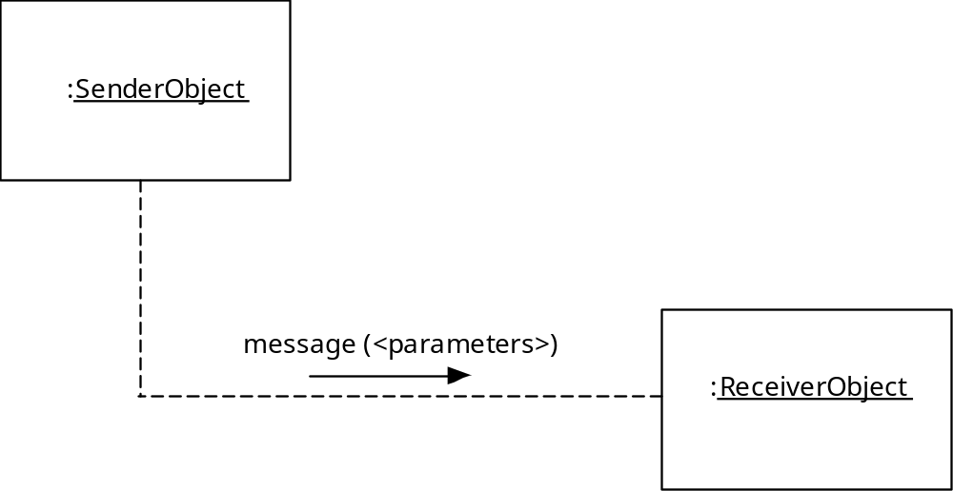
Messages
Software Engineering

Slide 24
Polymorphism
Conventional approach …
case of graphtype:
if graphtype = linegraph then DrawLineGraph (data);
if graphtype = piechart then DrawPieChart (data);
if graphtype = histogram then DrawHisto (data);
if graphtype = kiviat then DrawKiviat (data);
end case;
All of the graphs become subclasses of a general class called graph. Using a concept called overloading [TAY90], each subclass defines an operation called draw. An object can send a draw message to any one of the objects instantiated from any one of the subclasses. The object receiving the message will invoke its own draw operation to create the appropriate graph.
graphtype draw
Software Engineering

Slide 25

The Design Model
Software Engineering

Slide 26
Design Model Elements
Data elements
  Data model --> data structures
  Data model --> database architecture
Architectural elements
  Application domain
  Analysis classes, their relationships, collaborations and behaviors are transformed into design realizations
  Patterns and “styles”
Interface elements
  the user interface (UI)
  external interfaces to other systems, devices, networks or other producers or consumers of information
  internal interfaces between various design components.
Component elements
Deployment elements
Software Engineering

Slide 27
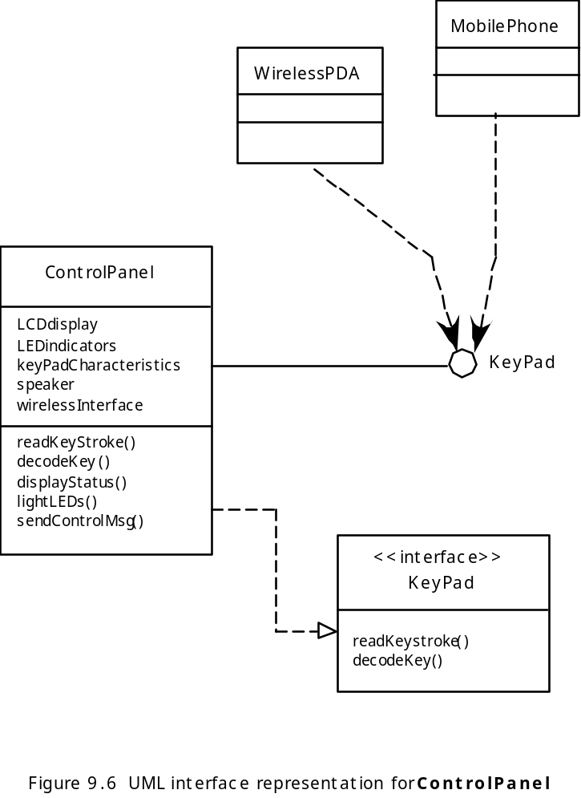
Interface Elements
Software Engineering

Slide 28
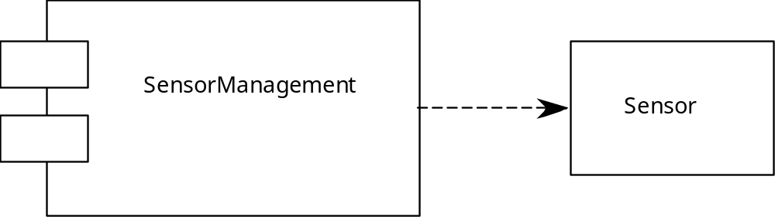
Component Elements
Software Engineering

Slide 29
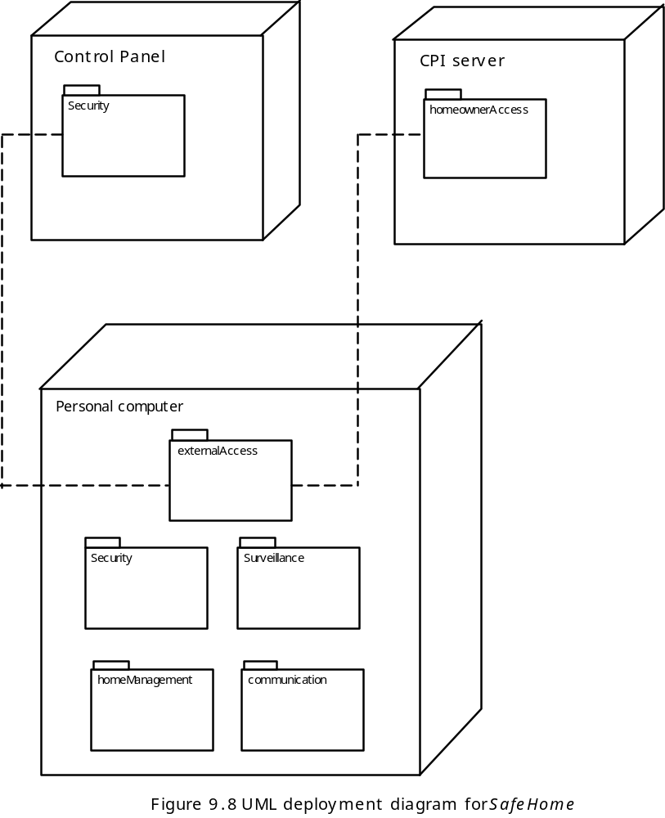
Deployment Elements
Software Engineering

Slide 30
Part II. Software Architecture
.
Software Engineering

Slide 31
Why Architecture?
The architecture is not the operational software. Rather, it is a representation that enables a software engineer to:
(1) analyze the effectiveness of the design in meeting its stated requirements,
(2) consider architectural alternatives at a stage when making design changes is still relatively easy, and
(3) reduce the risks associated with the construction of the software.
Software Engineering

Slide 32
Why is Architecture Important?
Representations of software architecture are an enabler for communication between all parties (stakeholders) interested in the development of a computer-based system.
The architecture highlights early design decisions that will have a profound impact on all software engineering work that follows and, as important, on the ultimate success of the system as an operational entity.
Architecture “constitutes a relatively small, intellectually graspable model of how the system is structured and how its components work together” .
Software Engineering

Slide 33
Architectural Styles
Each style describes a system category that encompasses: (1) a set of components (e.g., a database, computational modules) that perform a function required by a system, (2) a set of connectors that enable “communication, coordination and cooperation” among components, (3) constraints that define how components can be integrated to form the system, and (4) semantic models that enable a designer to understand the overall properties of a system by analyzing the known properties of its constituent parts.
Data-centered architectures
Data flow architectures
Call and return architectures
Object-oriented architectures
Layered architectures
Software Engineering

Slide 34
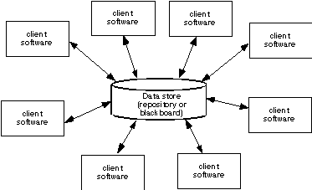
Data-Centered Architecture
Software Engineering

Slide 35
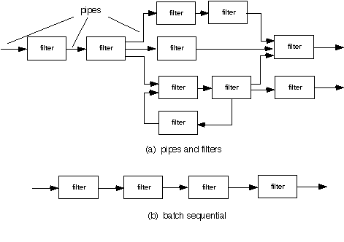
Data Flow Architecture
Software Engineering

Slide 36
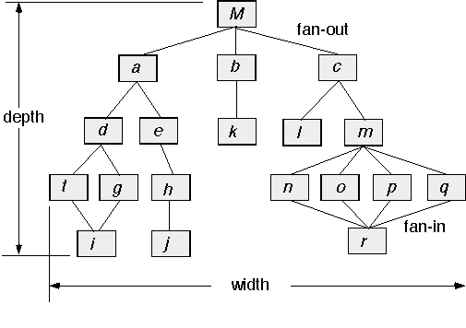
Call and Return Architecture
Software Engineering

Slide 37
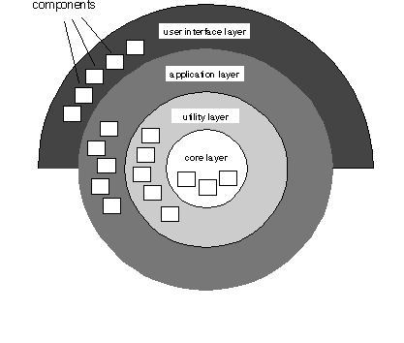
Layered Architecture
Software Engineering

Slide 38
Architectural Patterns
Concurrency—applications must handle multiple tasks in a manner that simulates parallelism
  operating system process management pattern
  task scheduler pattern
Persistence—Data persists if it survives past the execution of the process that created it. Two patterns are common:
  a database management system pattern that applies the storage and retrieval capability of a DBMS to the application architecture
  an application level persistence pattern that builds persistence features into the application architecture
Distribution— the manner in which systems or components within systems communicate with one another in a distributed environment
  A broker acts as a ‘middle-man’ between the client component and a server component.
Software Engineering

Slide 39
Architectural Design
The software must be placed into context
  the design should define the external entities (other systems, devices, people) that the software interacts with and the nature of the interaction
A set of architectural archetypes should be identified
  An archetype is an abstraction (similar to a class) that represents one element of system behavior
The designer specifies the structure of the system by defining and refining software components that implement each archetype
Software Engineering

Slide 40
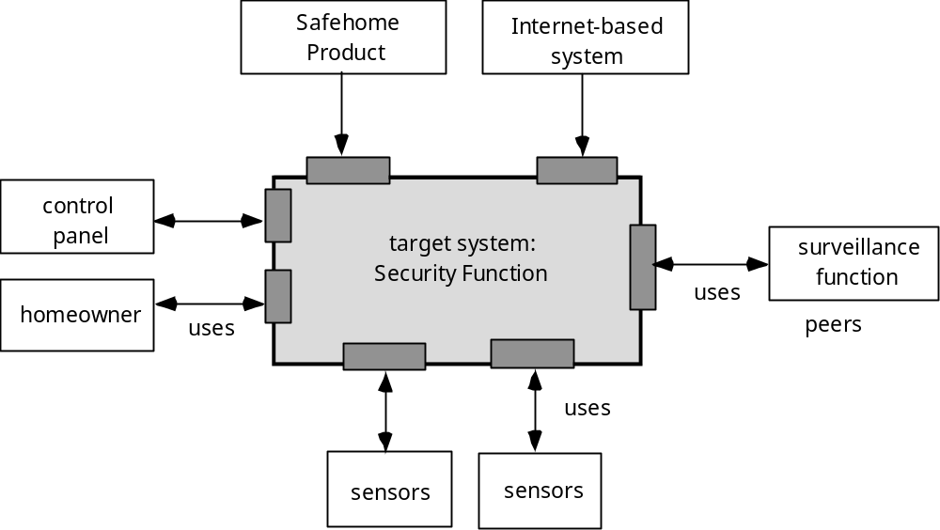
Architectural Context
Software Engineering

Slide 41
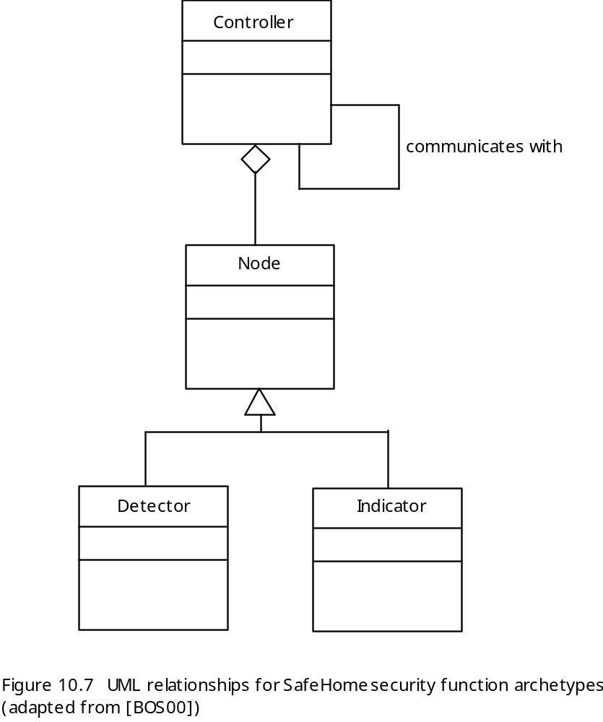
Archetypes
Software Engineering

Slide 42
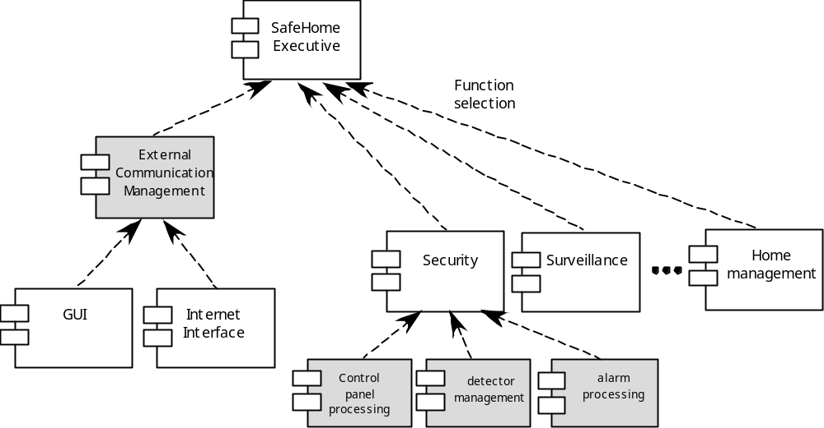
Component Structure
Software Engineering

Slide 43
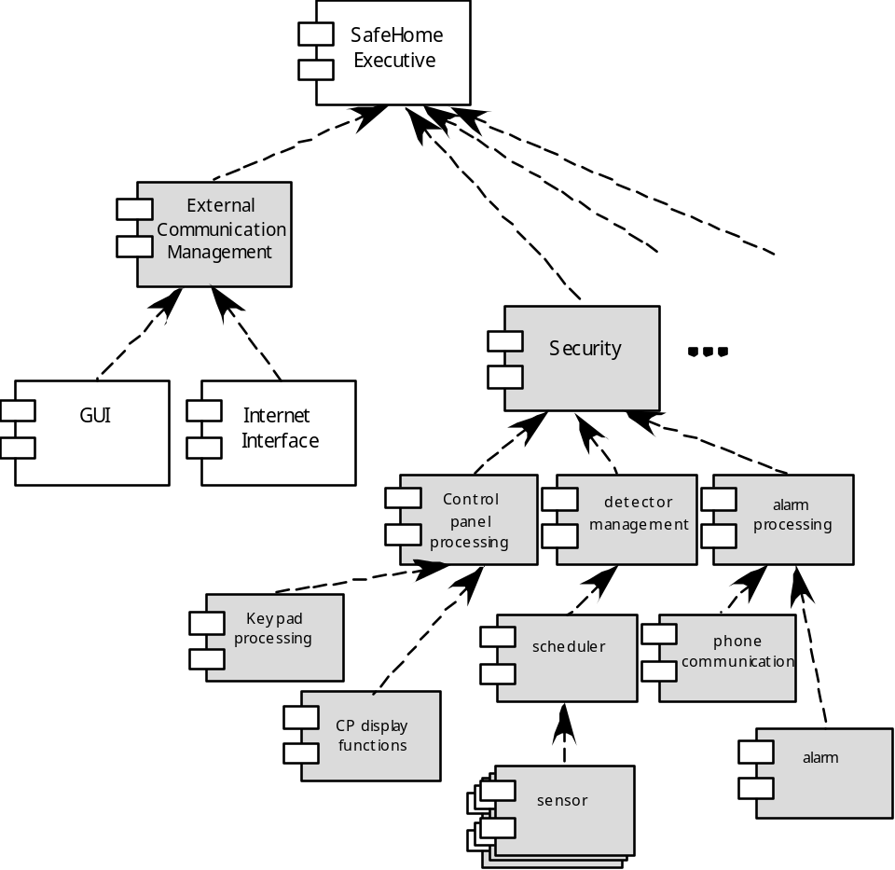
Refined Component Structure
Software Engineering

Slide 44
Analyzing Architectural Design
1. Collect scenarios.
2. Elicit requirements, constraints, and environment description.
3. Describe the architectural styles/patterns that have been chosen to address the scenarios and requirements:
• module view
• process view
• data flow view
4. Evaluate quality attributes by considered each attribute in isolation.
5. Identify the sensitivity of quality attributes to various architectural attributes for a specific architectural style.
6. Critique candidate architectures (developed in step 3) using the sensitivity analysis conducted in step 5.
Software Engineering

Slide 45
An Architectural Design Method
customer requirements
"four bedrooms, three baths,
lots of glass ..."
architectural design
Software Engineering

Slide 46
Deriving Program Architecture
Program
Architecture
Software Engineering

Slide 47
Partitioning the Architecture
“horizontal” and “vertical” partitioning are required
Software Engineering

Slide 48
Horizontal Partitioning
define separate branches of the module hierarchy for each major function
use control modules to coordinate communication between functions
function 1
function 3
function 2
Software Engineering

Slide 49
Vertical Partitioning: Factoring
design so that decision making and work are stratified
decision making modules should reside at the top of the architecture
decision-makers
workers
Software Engineering

Slide 50
Why Partitioned Architecture?
results in software that is easier to test
leads to software that is easier to maintain
results in propagation of fewer side effects
results in software that is easier to extend
Software Engineering

Slide 51
Part III: Component Design
Software Engineering

Slide 52
What is Component Level Design?
A complete set of software components is defined during architectural design
But the internal data structures and processing details of each component are not represented at a level of abstraction that is close to code
Component-level design defines the data structures, algorithms, interface characteristics, and communication mechanisms allocated to each component
Software Engineering

Slide 53
Component Views
OO View – A component is a set of collaborating classes.
Conventional View – A component is a functional element of a program that incorporates processing logic, the internal data structures required to implement the processing logic, and an interface that enables the component to be invoked and data to be passed to it.
Software Engineering

Slide 54
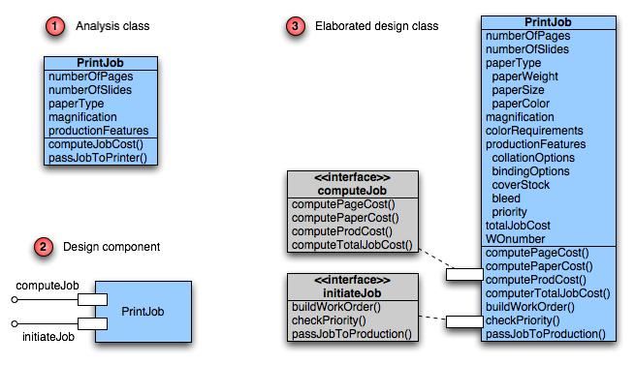
Class Elaboration
Software Engineering

Slide 55
Design Principles
Design by Contract
Open-Closed Principle
Subtype Substitution
Depend on Abstractions
Interface Segregation
Software Engineering

Slide 56
Design by Contract
The relationship between a class and its clients can be viewed as a formal agreement, expressing each party’s rights and obligations.
Consider the following list operation:
public Item remove(int index)
  requires the specified index is in range ( 0 ≤ index < size( ) )
  ensures the element at the specified position in this list is removed, subsequent elements are shifted to the left ( 1 is subtracted from their indices ), and the element that was removed is returned
Software Engineering

Slide 57
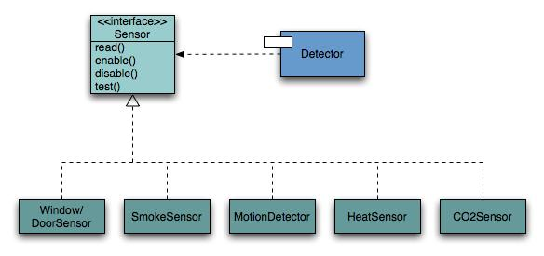
Open-Closed Principle
A module should be open for extension but closed for modification.
Software Engineering

Slide 58
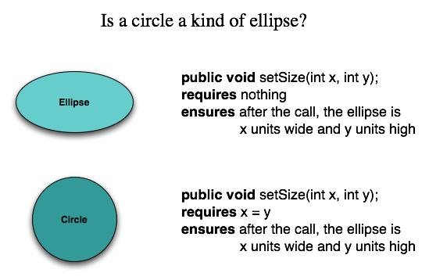
Substitutability
Subclasses should be substitutable for base classes
Software Engineering

Slide 59
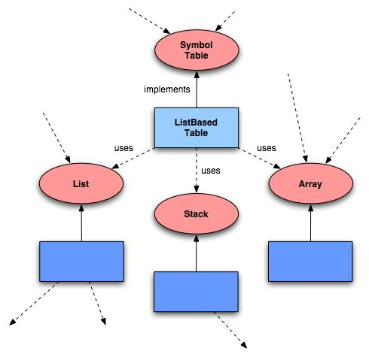
Dependency Inversion
Depend on abstractions. Do not depend on concretions.
Software Engineering

Slide 60
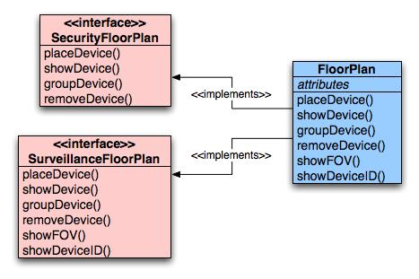
Interface Segregation
Many client-specific interfaces are better than one general purpose interface.
Software Engineering

Slide 61
Cohesion
The “single-mindedness” of a module
cohesion implies that a single component or class encapsulates only attributes and operations that are closely related to one another and to the class or component itself.
Examples of cohesion
  Functional
  Layer
  Communicational
Software Engineering

Slide 62
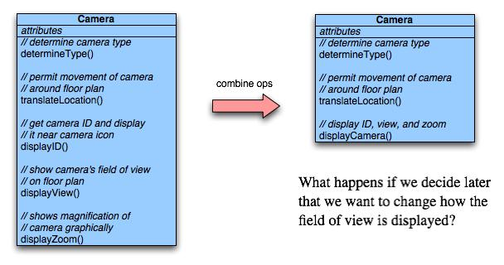
Functional Cohesion
Typically applies to operations. Occurs when a module performs one and only one computation and then returns a result.
Software Engineering

Slide 63
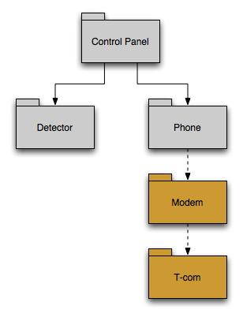
Layer Cohesion
Applies to packages, components, and classes. Occurs when a higher layer can access a lower layer, but lower layers do not access higher layers.
Software Engineering

Slide 64
Communicational Cohesion
All operations that access the same data are defined within one class.
In general, such classes focus solely on the data in question, accessing and storing it.
Example: A StudentRecord class that adds, removes, updates, and accesses various fields of a student record for client components.
Software Engineering

Slide 65
Coupling
A qualitative measure of the degree to which classes or components are connected to each other.
Avoid
  Content coupling
Use caution
  Common coupling
Be aware
  Routine call coupling
  Type use coupling
  Inclusion or import coupling
Software Engineering

Slide 66
Content Coupling
Occurs when one component “surreptitiously modifies data that is internal to another component”
Violates information hiding
What’s wrong here? →
public class StudentRecord {
private String name;
private int[ ] quizScores;
public String getName() {
return name;
}
public int getQuizScore(int n) {
return quizScores[n];
}
public int[ ] getAllQuizScores() {
return quizScores;
}
….
Software Engineering

Slide 67
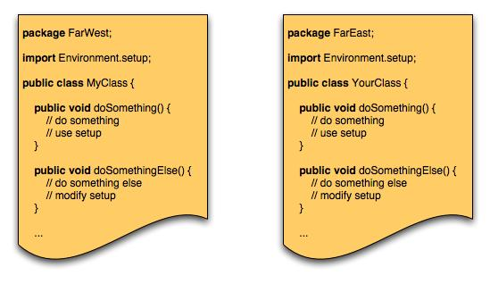
Common Coupling
Occurs when a number of components all make use of a global variable.
Software Engineering

Slide 68
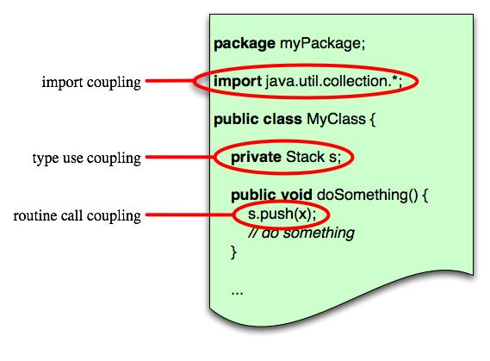
Routine Coupling
Certain types of coupling occur routinely in object-oriented programming.
Software Engineering

Slide 69
Conducting Component-Level Design
Identify design classes in problem domain
Identify infrastructure design classes
Elaborate design classes
Describe persistent data sources
Elaborate behavioral representations
Elaborate deployment diagrams
Refactor design and consider alternatives
Software Engineering

Slide 70
Steps 1 & 2 – Identify Classes
Most classes from the problem domain are analysis classes created as part of the analysis model
The infrastructure design classes are introduced as components during architectural design
Software Engineering

Slide 71
Step 3 – Class Elaboration
Specify message details when classes or components collaborate
Identify appropriate interfaces for each component
Elaborate attributes and define data structures required to implement them
Describe processing flow within each operation in detail
Software Engineering

Slide 72
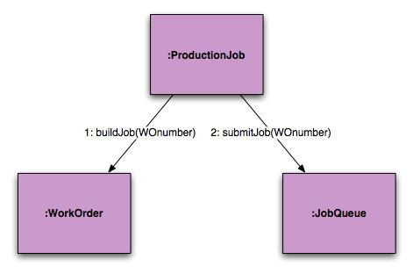
3a. Collaboration Details
Messages can be elaborated by expanding their syntax in the following manner:
  [guard condition] sequence expression (return value) :=
  message name (argument list)
Software Engineering

Slide 73
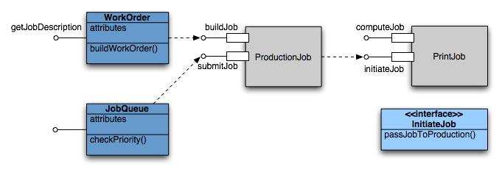
3b. Appropriate Interfaces
Pressman argues that the PrintJob interface “initiateJob” in slide 5 does not exhibit sufficient cohesion because it performs three different subfunctions. He suggests this refactoring.
Software Engineering

Slide 74
3c. Elaborate Attributes
Analysis classes will typically only list names of general attributes (ex. paperType).
List all attributes during component design.
UML syntax:
  name : type-expression = initial-value { property string }
For example, paperType can be broken into weight, size, and color. The weight attribute would be:
  paperType-weight: string =
  “A” { contains 1 of 4 values – A, B, C, or D }
Software Engineering

Slide 75
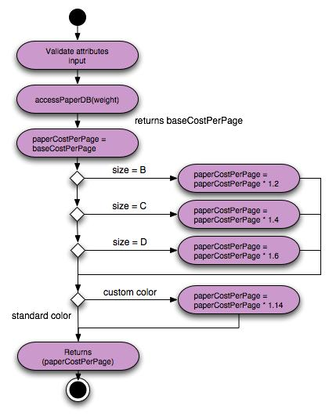
3d. Describe Processing Flow
Activity diagram for computePaperCost( )
Software Engineering

Slide 76

Step 4 – Persistent Data
Describe persistent data sources (databases and files) and identify the classes required to manage them.
Software Engineering

Slide 77
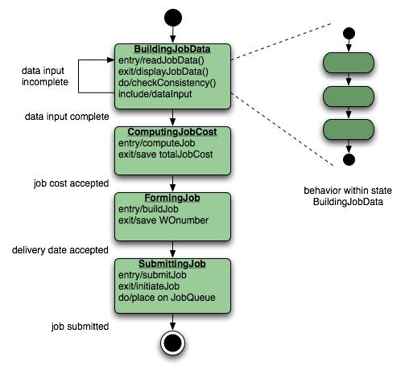
Step 5 – Elaborate Behavior
It is sometimes necessary to model the behavior of a design class.
Transitions from state to state have the form:
  Event-name (parameter-list) [guard-condition] / action expression
Software Engineering

Slide 78
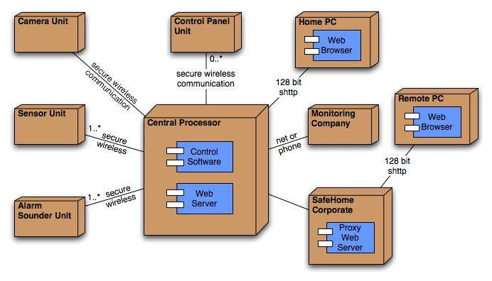
Step 6 – Elab. Deployment
Deployment diagrams are elaborated to represent the location of key packages or components.
Software Engineering

Slide 79
Step 7 – Redesign/Reconsider
The first component-level model you create will not be as complete, consistent, or accurate as the n^{th} iteration you apply to the model.
The best designers will consider many alternative design solutions before settling on the final design model.
Software Engineering

Slide 80
Component Design for WebApps
WebApp component is
  (1) a well-defined cohesive function that manipulates content or provides computational or data processing for an end-user, or
  (2) a cohesive package of content and functionality that provides end-user with some required capability.
Therefore, component-level design for WebApps often incorporates elements of content design and functional design.
Software Engineering

Slide 81
Content Design for WebApps
focuses on content objects and the manner in which they may be packaged for presentation to a WebApp end-user
consider a Web-based video surveillance capability within SafeHomeAssured.com
  potential content components can be defined for the video surveillance capability:
    (1) the content objects that represent the space layout (the floor plan) with additional icons representing the location of sensors and video cameras;
    (2) the collection of thumbnail video captures (each an separate data object), and
    (3) the streaming video window for a specific camera.
  Each of these components can be separately named and manipulated as a package.
Software Engineering

Slide 82
Functional Design for WebApps
Modern Web applications deliver increasingly sophisticated processing functions that:
  (1) perform localized processing to generate content and navigation capability in a dynamic fashion;
  (2) provide computation or data processing capability that is appropriate for the WebApp’s business domain;
  (3) provide sophisticated database query and access, or
  (4) establish data interfaces with external corporate systems.
To achieve these (and many other) capabilities, you will design and construct WebApp functional components that are identical in form to software components for conventional software.
Software Engineering

Slide 83
Part IV. User Interface Design
Software Engineering

Slide 84

Interface Design
Easy to learn?
Easy to use?
Easy to understand?
Typical Design Errors
lack of consistency
too much memorization
no guidance / help
no context sensitivity
poor response
unfriendly
Software Engineering

Slide 85
Golden Rules
Place the user in control
Reduce the user’s memory load
Make the interface consistent
Software Engineering

Slide 86
Place the User in Control
Define interaction modes in a way that does not force a user into unnecessary or undesired actions.
Provide for flexible interaction.
Allow user interaction to be interruptible and undoable.
Streamline interaction as skill levels advance and allow the interaction to be customized.
Hide technical internals from the casual user.
Design for direct interaction with objects that appear on the screen.
Software Engineering

Slide 87
Reduce the User’s Memory Load
Reduce demand on short-term memory.
Establish meaningful defaults.
Define shortcuts that are intuitive.
The visual layout of the interface should be based on a real world metaphor.
Disclose information in a progressive fashion.
Software Engineering

Slide 88
Make the Interface Consistent
Allow the user to put the current task into a meaningful context.
Maintain consistency across a family of applications.
If past interactive models have created user expectations, do not make changes unless there is a compelling reason to do so.
Software Engineering

Slide 89
User Interface Design Models
User model — a profile of all end users of the system
Design model — a design realization of the user model
Mental model (system perception) — the user’s mental image of what the interface is
Implementation model — the interface “look and feel” coupled with supporting information that describe interface syntax and semantics
Software Engineering

Slide 90
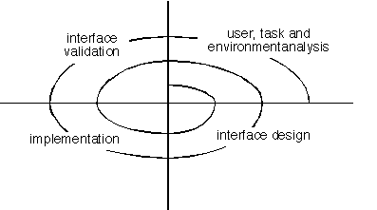
User Interface Design Process
Software Engineering

Slide 91
Interface Analysis
Interface analysis means understanding
  (1) the people (end-users) who will interact with the system through the interface;
  (2) the tasks that end-users must perform to do their work,
  (3) the content that is presented as part of the interface
  (4) the environment in which these tasks will be conducted.
Software Engineering

Slide 92
Analysis of Display Content
Are different types of data assigned to consistent geographic locations on the screen (e.g., photos always appear in the upper right hand corner)?
Can the user customize the screen location for content?
Is proper on-screen identification assigned to all content?
If a large report is to be presented, how should it be partitioned for ease of understanding?
Will mechanisms be available for moving directly to summary information for large collections of data.
Will graphical output be scaled to fit within the bounds of the display device that is used?
How will color to be used to enhance understanding?
How will error messages and warning be presented to the user?
Software Engineering

Slide 93
Interface Design Steps
Using information developed during interface analysis, define interface objects and actions (operations).
Define events (user actions) that will cause the state of the user interface to change. Model this behavior.
Describe each interface state as it will actually look to the end-user.
Indicate how the user interprets the state of the system from information provided through the interface.
Software Engineering

Slide 94
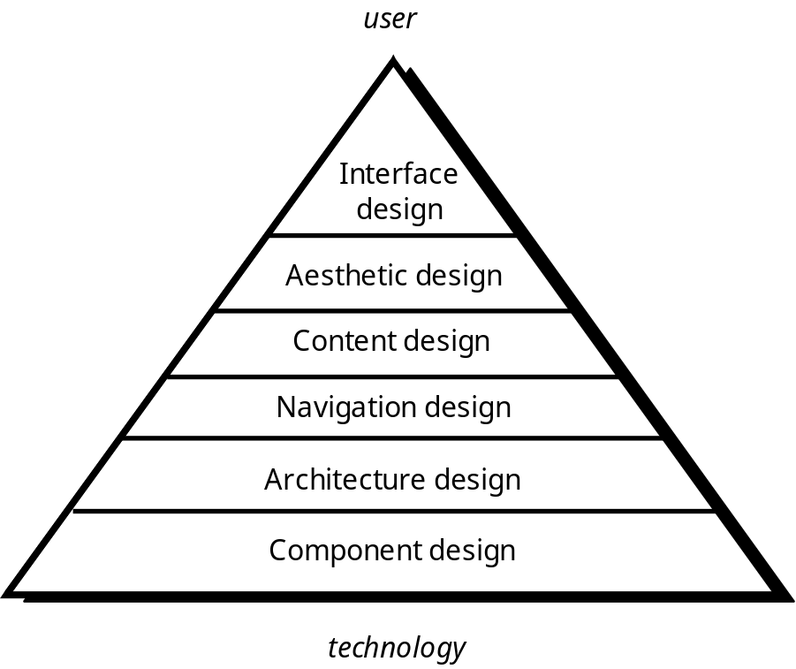
WebE Design Pyramid
Software Engineering

Slide 95
WebApp Interface Design
Where am I? The interface should
  provide an indication of the WebApp that has been accessed
  inform the user of her location in the content hierarchy.
What can I do now? The interface should always help the user understand his current options
  what functions are available?
  what links are live?
  what content is relevant?
Where have I been, where am I going? The interface must facilitate navigation.
  Provide a “map” (implemented in a way that is easy to understand) of where the user has been and what paths may be taken to move elsewhere within the WebApp.
Software Engineering

Slide 96
Interface Design Principles-I
Anticipation—A WebApp should be designed so that it anticipates the use’s next move.
Communication—The interface should communicate the status of any activity initiated by the user
Consistency—The use of navigation controls, menus, icons, and aesthetics (e.g., color, shape, layout)
Controlled autonomy—The interface should facilitate user movement throughout the WebApp, but it should do so in a manner that enforces navigation conventions that have been established for the application.
Efficiency—The design of the WebApp and its interface should optimize the user’s work efficiency, not the efficiency of the Web engineer who designs and builds it or the client-server environment that executes it.
Software Engineering

Slide 97
Interface Design Principles-II
Focus—The WebApp interface (and the content it presents) should stay focused on the user task(s) at hand.
Fitt’s Law—“The time to acquire a target is a function of the distance to and size of the target.”
Human interface objects—A vast library of reusable human interface objects has been developed for WebApps.
Latency reduction—The WebApp should use multi-tasking in a way that lets the user proceed with work as if the operation has been completed.
Learnability— A WebApp interface should be designed to minimize learning time, and once learned, to minimize relearning required when the WebApp is revisited.
Software Engineering

Slide 98
Interface Design Principles-III
Maintain work product integrity—A work product (e.g., a form completed by the user, a user specified list) must be automatically saved so that it will not be lost if an error occurs.
Readability—All information presented through the interface should be readable by young and old.
Track state—When appropriate, the state of the user interaction should be tracked and stored so that a user can logoff and return later to pick up where she left off.
Visible navigation—A well-designed WebApp interface provides “the illusion that users are in the same place, with the work brought to them.”
Software Engineering

Slide 99
Design Issues
Response time
Help facilities
Error handling
Menu and command labeling
Application accessibility
Internationalization
Software Engineering

Slide 100
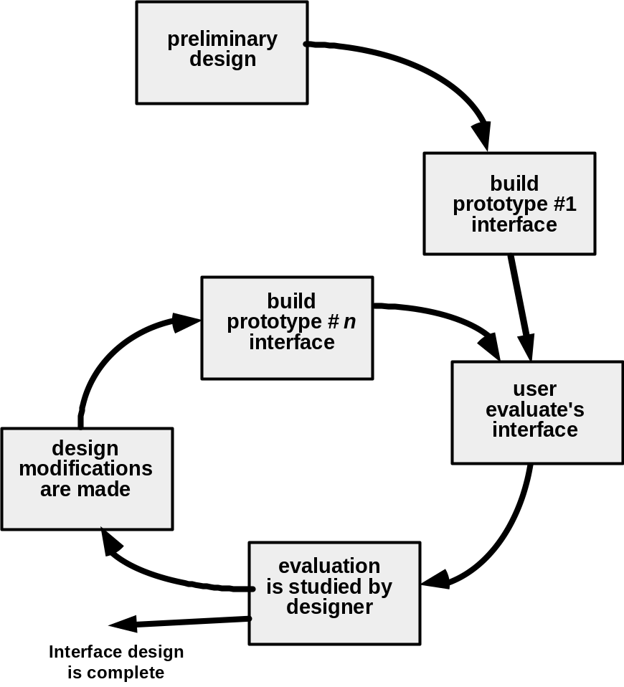
Design Evaluation Cycle
Software Engineering

Slide 101
Part V. Design Document and Evaluation
Software Engineering

Slide 102
Goals of Good Docs
Capture design consensus
Primary vision conduit between departments
Aid in scheduling
Offer focus
Give visibility to future dependencies and design conflicts
Software Engineering

Slide 103
Why is good design documentation so rare?
Design docs for most system deal with complex, interconnected systems.
Designers tend to overdesign.
  Systems take less time to design than to build.
  “Big Book of Stupid”
Most design docs don’t embrace iteration.
Most docs are rarely kept up to date as the project progresses.
Software Engineering

Slide 104
What’s Architecture
“the fundamental organization of a system, embodied in its components, their relationships to each other and the environment, and the principles governing its design and evolution”. (IEEE 1471)
Software Engineering

Slide 105
Software Architecture
Architecture is important
  it should be analyzed
Architecture can be prescribed
  decisions should be analyzed
Architecture is central for communicating
  it should be documented
Architecture is expensive to change
  it is cheaper to analyze early
Architecture affects the entire project
  many stakeholders should be involved
Requirements can be understood early
  architecture should be designed to meet them
Software Engineering

Slide 106
Why Evaluate an Architecture?
The cost to fix an error found during requirements or early design phases is orders of magnitudes less to correct than error found in testing.
Architecture determines the structure of the project: schedules and budgets, performance goals, team structure, documentation organization, and testing and maintenance activities.
Software Engineering

Slide 107
How to validate a software architecture?
A suite of three methods, all developed at the Software Engineering Institute.
  ATAM: Architecture Tradeoff Analysis Method
  SAAM: Software Architecture Analysis Method
  ARID: Active Reviews for Intermediate Designs
Software Engineering

Slide 108
Software Architecture Analysis Method (SAAM)
aims to predict the quality of a system before it has been developed.
the quality of the architecture is validated by analyzing the impact of predefined scenarios on architectural components.
addresses concerns at the architecture design level which inherently crosscut multiple architectural components.
Software Engineering

Slide 109
Active Reviews for Intermediate Designs (ARID)
method for reviewing preliminary software designs (such as for a component or a subsystem) for suitability in its intended usage context and environment.
result in a high-fidelity design review coupled with high-quality familiarization with the design.
Software Engineering

Slide 110
ATAM - Vocabulary
Scenario – A scenario is a short statement describing an interaction of one of the stakeholders with the system
Stakeholder – An individual, team, or organization (or classes thereof) with interests in, or concerns relative to, a system
Architectural view – A representation of a whole system from the perspective of a related set of concerns
Functional requirements - specify what software has to do.
Non-functional requirements specify how well it should be done.
Software Engineering

Slide 111
What’s ATAM
Purpose: To assess the consequences of architectural decisions in light of quality attribute* requirements.
Primarily a risk identification mechanism
Not a predictor of quality achievement
*Quality attribute = “ilities”
Software Engineering

Slide 112

System Quality Attribute
Performance
Availability
Usability
Security
Time To Market
Cost and Benefits
Projected life time
Targeted Market
Integration with Legacy System
Roll back Schedule
End User’s view
Business
Community
view
Maintainability
Portability
Reusability
Testability
Developer’s view
Software Engineering

Slide 113
ATAM – Cost/Benefit
Cost
  1 – 2 weeks of time for 8 – 10 highly paid people, 2 days for another 10-12 people (for full formal process!)
  Delays project start
  Forces development of architecture up front
Benefit
  Financial – saves money
  Forces preparation / documentation / understanding
  Captures rationale
  Catch architectural errors before built
  Make sure architecture meets scenarios
  More general, flexible architecture
  Reduces risk
Software Engineering

Slide 114
ATAM Steps
Phase 1 – evaluators and decision makers
  Present
    ATAM
    Business drivers
    Architecture
  Identify architectural approaches
  Generate quality attribute utility tree
  Analyze architectural approaches
Phase 2 – add stakeholders
  Brainstorm and prioritize scenarios
  Analyze architectural approaches
  Present results
Phase 3
  Analyze cost / benefit of ATAM
Repeat the last steps of phase 1
In a broader forum…
Software Engineering

Slide 115
HASARD Method
HASARD – Hazard Analysis of Software ARchitectural Designs
This method is based on a kind of system analysis techniques, which is widely used in analyzing safety related systems in various industry sectors.
This method is intended to find out how well a software architectural design meets quality requirements specified in the form of scenarios.
A common weakness of the previous methods is that they have limited power to discover unknown problems that are not elicited and explicitly specified by quality requirements. HASARD method helps to overcome this problem.
Software Engineering

Slide 116
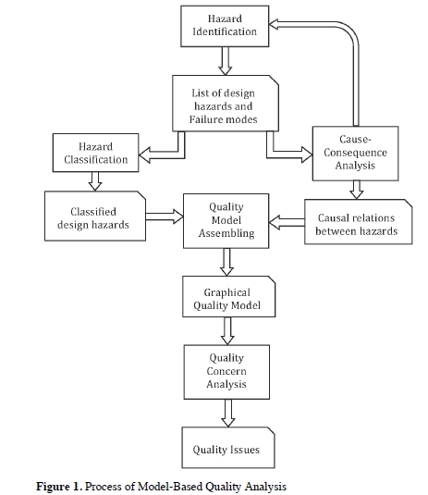
Software Engineering

Slide 117
HASARD Steps
What – if checklist
A review team is selected;
The review team methodically examines the process from elicitation of requirements to delivery of products, at each step the group collectively generates the list of what – if questions regarding the safety and quality of design;
Answers are developed for each question. The review team then works to achieve a consensus on each question and answer. From these answers, a listing of recommendations, along with the list of questions and answers, become the key elements of the report;
The same list is to be taken care by design team during design process.
Software Engineering

